Slide 1


Cloud Project
Daniel Fraimovich - 315880963 Roi Shamayev – 207776568 Shimron Ifrah - 312423247 Netanel Iyov - 206239857 Michael Trifonov - 321110645 Amir Mishayev - 318212107

Slide 2

Introduction
The main purpose is to provide users with a highly tailored and efficient way to search for relevant information within this specific area.
key features:
Clean
Advanced and professional
Intuitive and User-Friendly

Slide 3
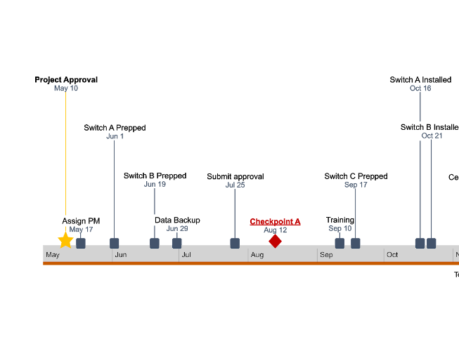
Project Overview

Slide 4
Project Requirements
Search Functionality
User Authentication
Database Integration
Statistics
Chatbot Integration
Implementing search algorithms
Allowing users to register with a username and password
Displaying search results
Implementing user mechanisms for login and logout
Integrating with a Firebase database system
Calculating and displaying relevant statistics
Integrating a chatbot for user support and assistance.
Storing indexed data, user information, and search history in the database
Generating visualizations
Handling user queries and providing relevant information or guidance

Slide 5
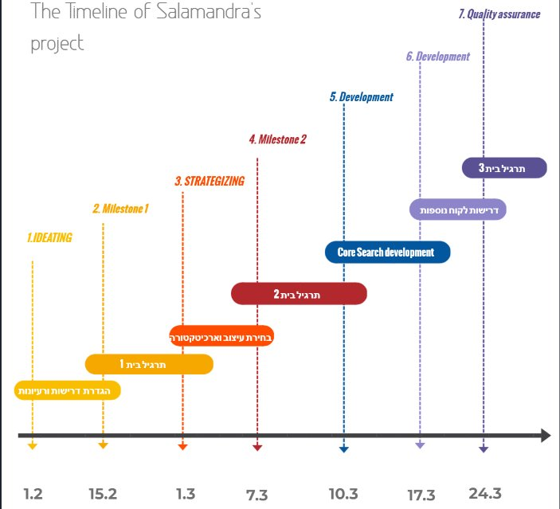

Slide 6
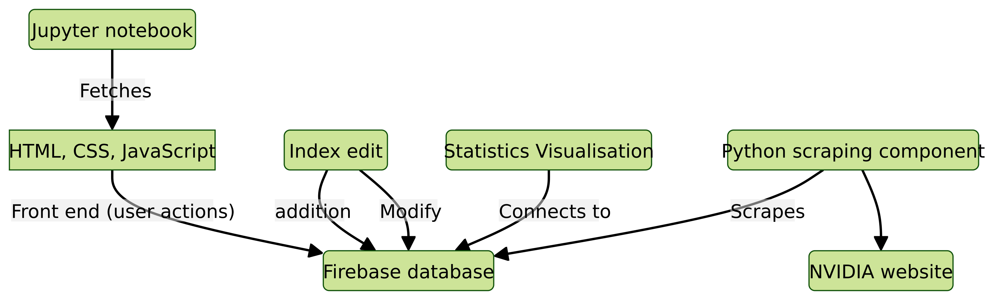
Project Architecture
Client-Server Architecture

Slide 7

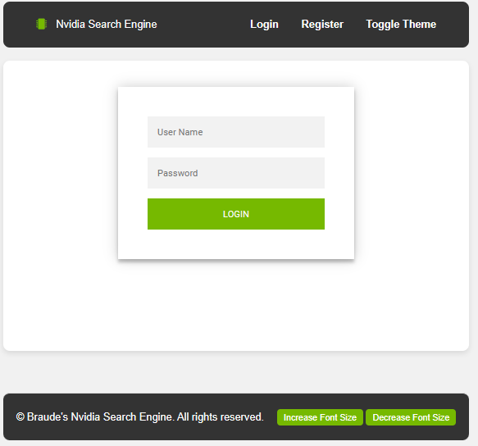
User login

Slide 8


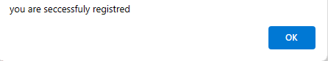
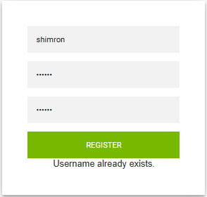
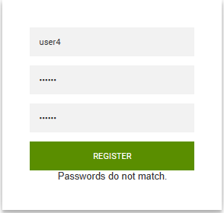
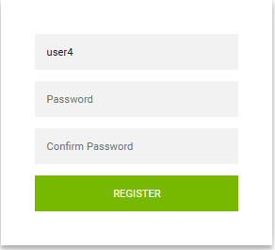
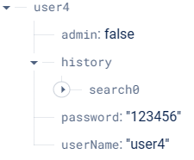
registration system
123456
123456

Slide 9
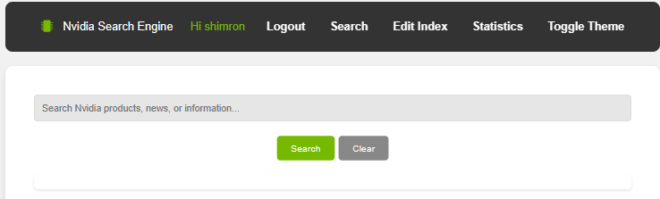
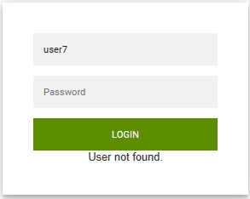
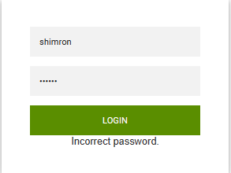
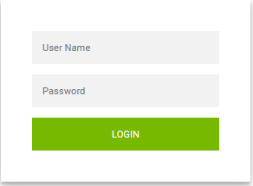
Login system
shimron
123456

Slide 10

Seach by index

Slide 11

01
Search Priority
First priority is given to documents containing all query terms, sorted by occurrence.
Secondary priority is given to documents with a higher number of unique terms, also sorted by occurrence.
02

Slide 12
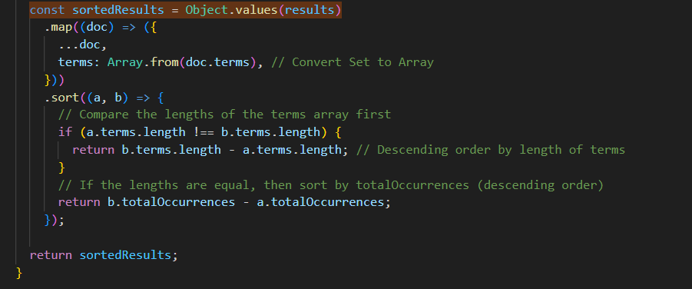
Code Snippets​

Slide 13
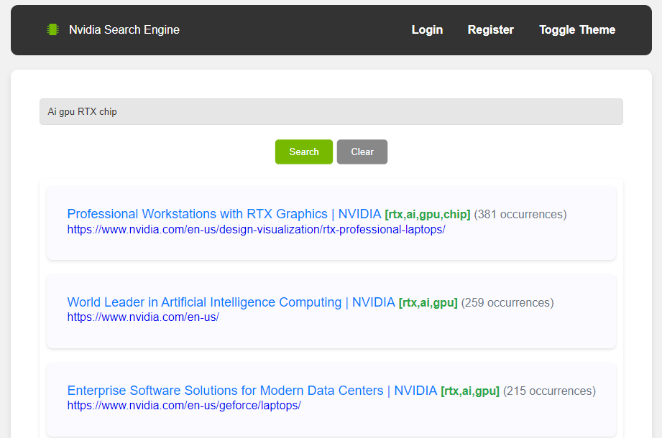
Outcome search results
Ensures that search results prioritize documents that comprehensively match the query terms.
Provides users with relevant and comprehensive results at the top of the search list.

Slide 14
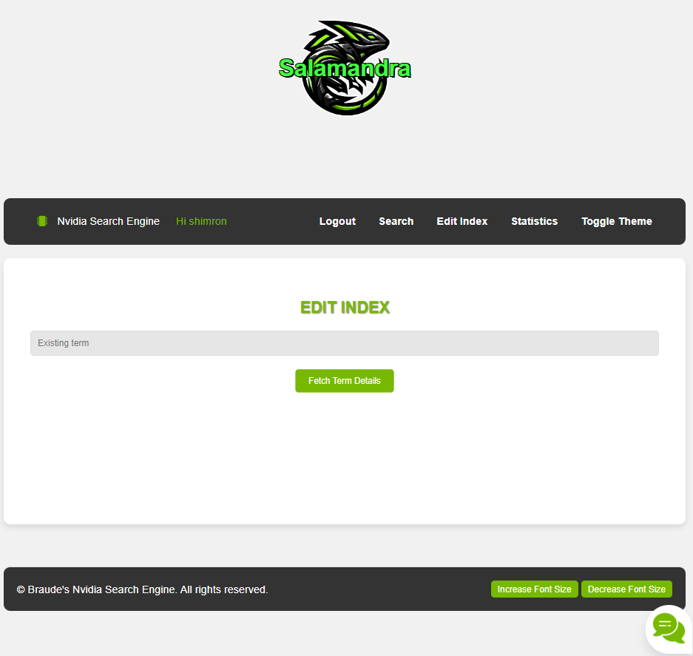
Add index/ Change index

Slide 15
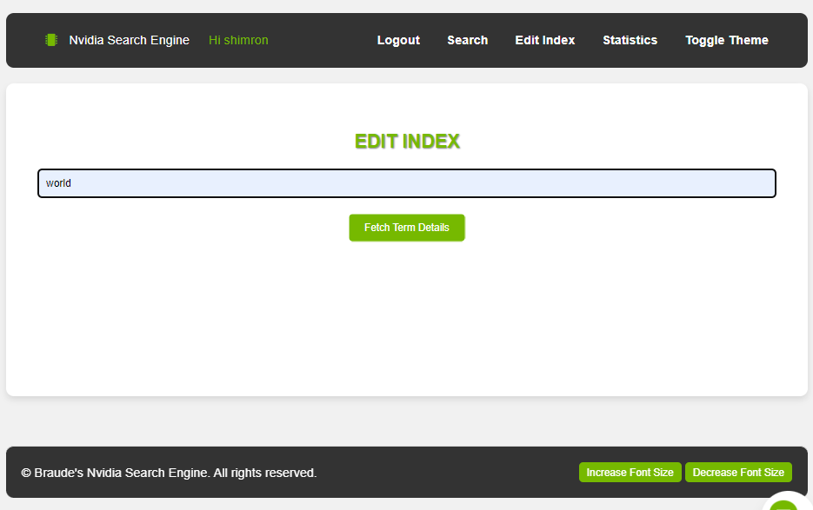
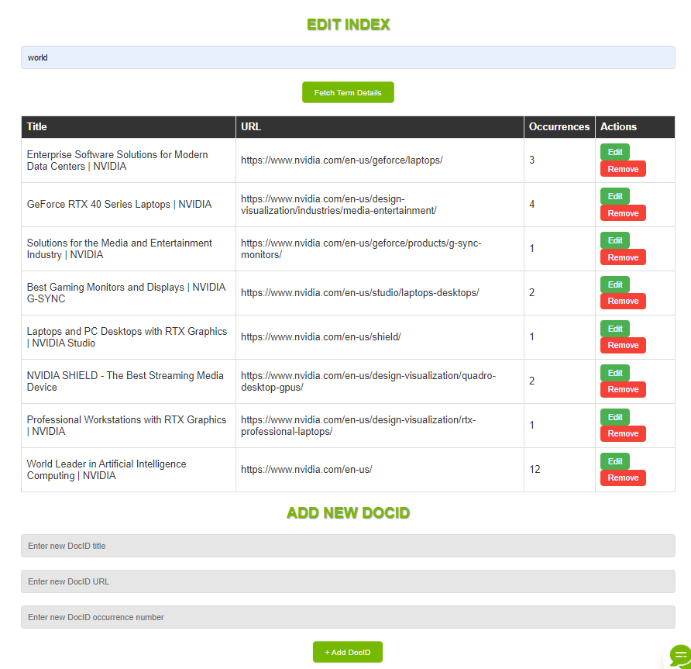
Edit Index

Slide 16
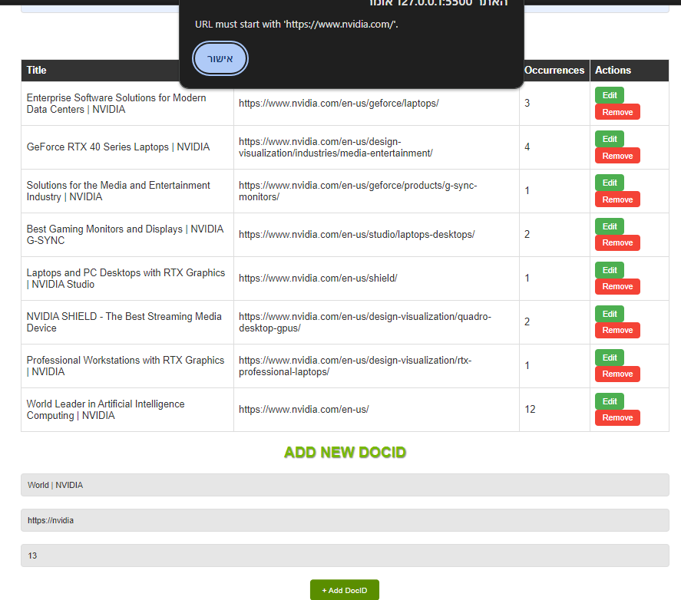
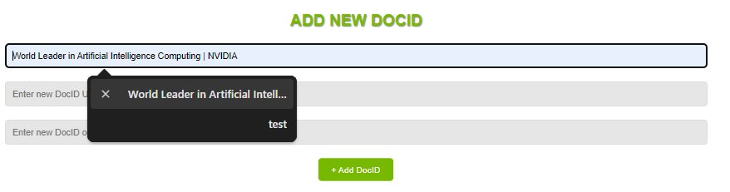
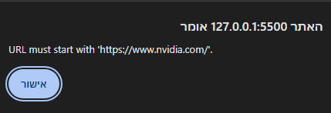
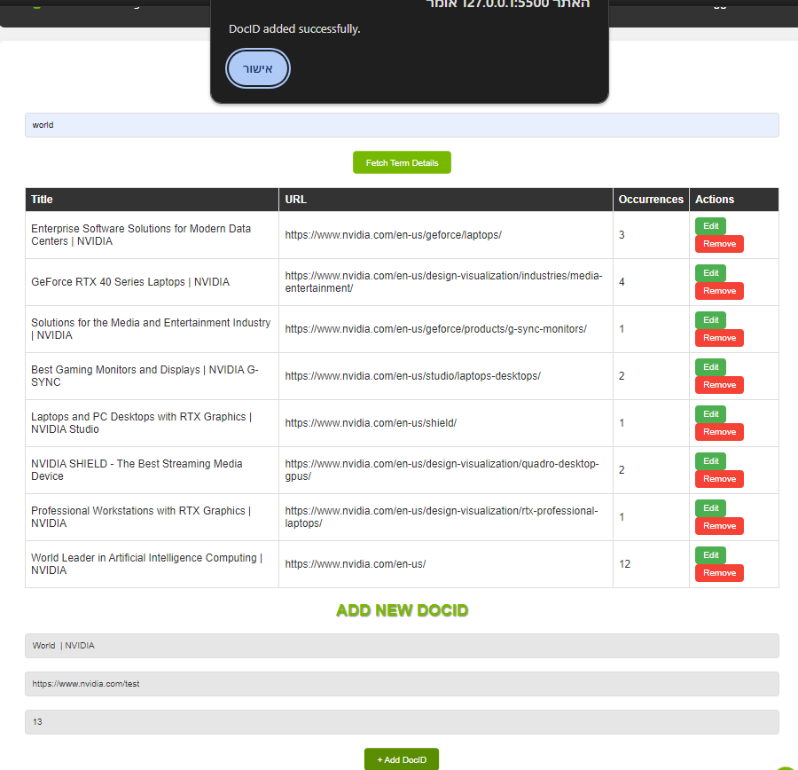
Edit Index – Add New DocID Flow

Slide 17
Chatbot
Introduction
Providing Nvidia Related Information
Simple & Minimalistic Design
Powered By Python Libraries

Slide 18
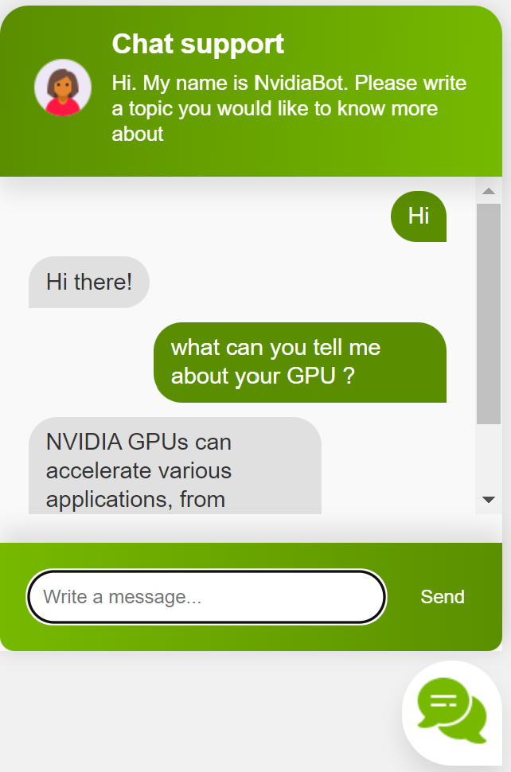
Overview
Powered By Python's nltk.chat.util.Chat Class
Responses are regex patterns based
Patterns support up to 50 Most Searched Terms
Chat Deletion For Privacy
Colab Inline Code Integration (google.colab.output module)

Slide 19
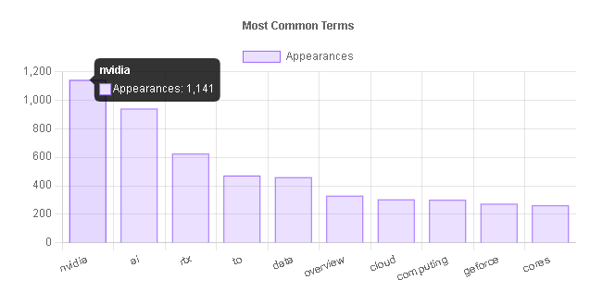
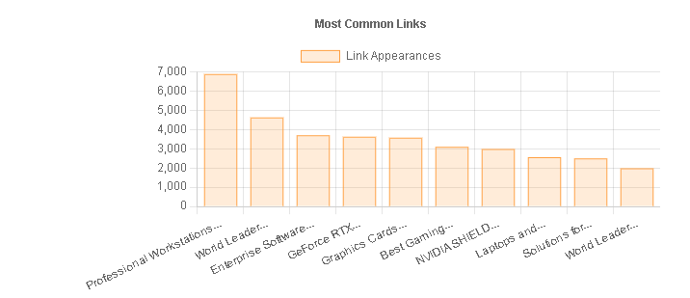
Statistics

Slide 20
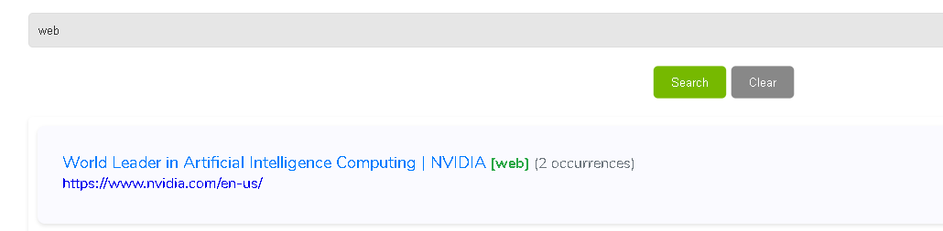
Each term has its corresponding links it appears in
And the number of times it appears there.
And after some math...

Slide 21
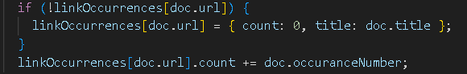
The math for the links are almost the same
Only difference is that it requires a bit more conditions.

Slide 22


Slide 23
Thank You.

